Slide 1

AOP Measurements
and
NN Bio-Optical Algorithms
for the Western Black Sea
Giuseppe Zibordi, Jean-Francois Berthon,
Davide D’Alimonte and Elisabetta Canuti
Joint Research Centre, European Commission, Ispra, Italy
Istanbul, 10-11 November 2011.

Slide 2
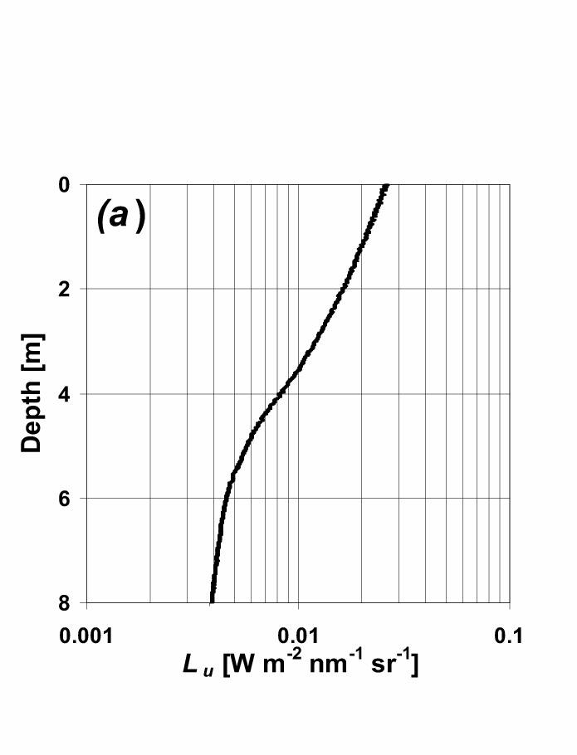
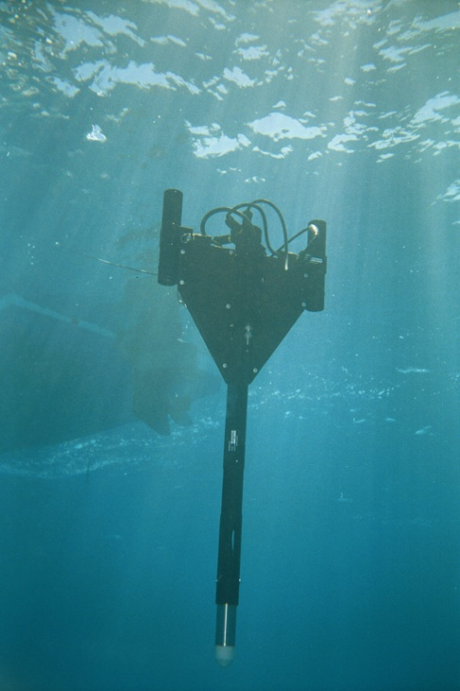
In-Water Radiometry
Extrapolation interval
z₁
z₂
Courtesy of S. Mc Lean
Satlantic Inc., Halifax
Fundamentals
~0.543
G.Zibordi, F. Mélin, S. B. Hooker, D. D’Alimonte and B. Holben. IEEE Transactions in Geoscience and Remote Sensing , 42:401-415, 2004 .

Slide 3
In-Water Radiometry: Products
[m⁻¹]
Diffuse attenuation coefficient
[sr]
Q-factor at nadir
[-]
Irradiance reflectance
[mW cm⁻² μm⁻¹ sr⁻¹]
Water leaving radiance
[mW cm⁻² μm⁻¹ sr⁻¹]
Normalized L_{W}
[sr⁻¹]
Remote sensing reflectance

Slide 4
L_{WN} Uncertainties (in-water)
Source | L_{WN}
 | 412 | 443 | 488 | 551 | 667
Absolute calibration | 2.8 | 2.8 | 2.8 | 2.8 | 2.8
Sensitivity change | 0.3 | 0.3 | 0.3 | 0.3 | 0.3
Correction | 2.2 | 1.7 | 1.1 | 0.6 | 2.6
C_{f/Q} | 0.3 | 0.4 | 0.8 | 0.9 | 0.5
E_{d}(0⁺) | 1.6 | 1.6 | 1.6 | 1.6 | 1.6
E₀ | 0.5 | 1.9 | 0.8 | 0.1 | 0.2
Environmental effects | 1.5 | 1.1 | 1.2 | 1.3 | 2.8
Quadrature sum | 4.2 | 4.3 | 3.8 | 3.7 | 5.0
Notes:
5

Slide 5
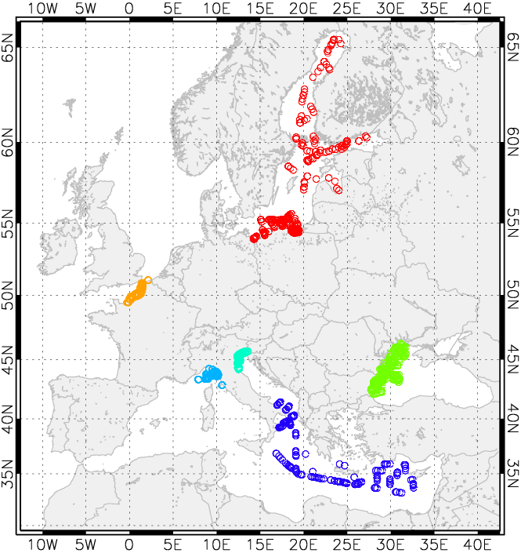






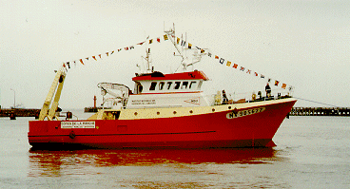
BiOMaP measurement stations (2000-2004)
BiOMaP measurements are produced applying cross-site identical and consolidated: technology, measurement and calibration protocols, processing codes and quality assurance criteria.
BiOMaP
Ships
G. Zibordi, J.-F. Berthon, F. Mélin and D. D’Alimonte. Cross-site consistent in situ measurements for satellite ocean color applications: the BiOMaP radiometric dataset. Remote Sensing of Environment,115, 2104–2115, 2011.

Slide 6
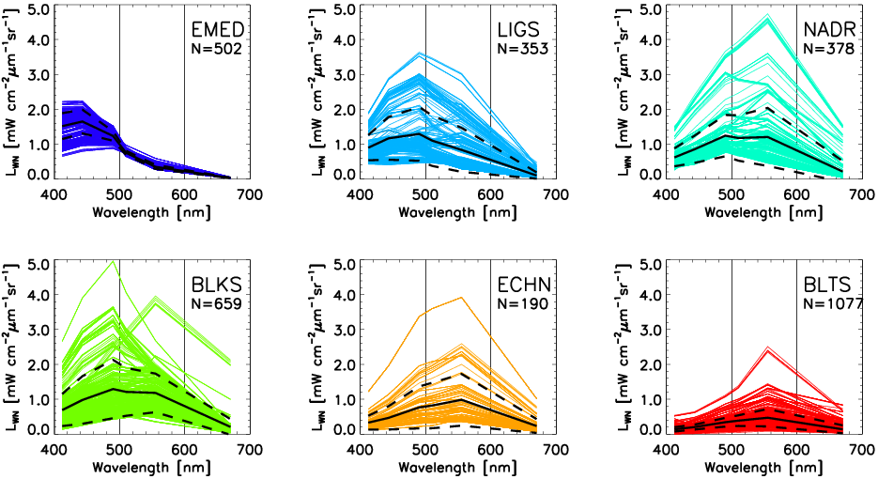
BiOMaP radiometric data form various European Seas
G. Zibordi, J.-F. Berthon, F. Mélin and D. D’Alimonte. Cross-site consistent in situ measurements for satellite ocean color applications: the BiOMaP radiometric dataset. Remote Sensing of Environment,115, 2104–2115, 2011.

Slide 7
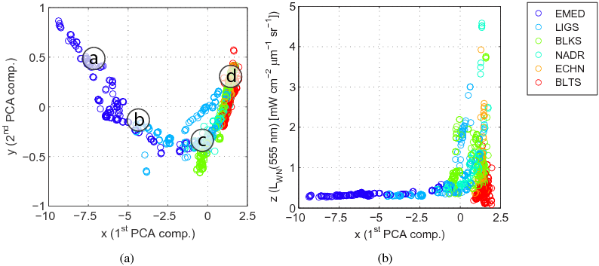
Tri-Dimensional Mapping of BiOMaP radiometric data
G. Zibordi, J.-F. Berthon, F. Mélin and D. D’Alimonte. Cross-site consistent in situ measurements for satellite ocean color applications: the BiOMaP radiometric dataset. Remote Sensing of Environment,115, 2104–2115, 2011.

Slide 8
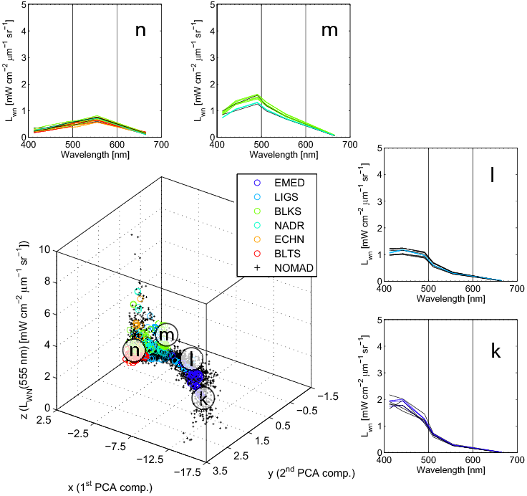
Tri-Dimensional Mapping of BiOMaP radiometric data
G. Zibordi, J.-F. Berthon, F. Mélin and D. D’Alimonte. Cross-site consistent in situ measurements for satellite ocean color applications: the BiOMaP radiometric dataset. Remote Sensing of Environment,115, 2104–2115, 2011.

Slide 9
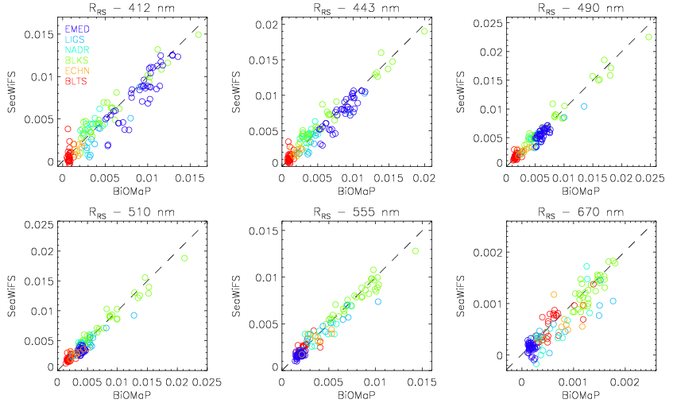
SeaWiFS –BiOMaP Match-Ups (including Black Sea)
G. Zibordi, J.-F. Berthon, F. Mélin and D. D’Alimonte. Cross-site consistent in situ measurements for satellite ocean color applications: the BiOMaP radiometric dataset. Remote Sensing of Environment,115, 2104–2115, 2011.

Slide 10
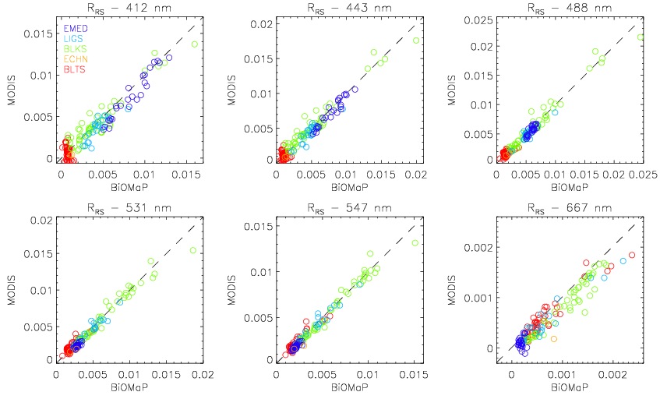
MODIS –BiOMaP Match-Ups (including Black Sea)
G. Zibordi, J.-F. Berthon, F. Mélin and D. D’Alimonte. Cross-site consistent in situ measurements for satellite ocean color applications: the BiOMaP radiometric dataset. Remote Sensing of Environment,115, 2104–2115, 2011.

Slide 11
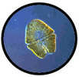
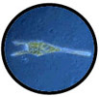
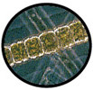
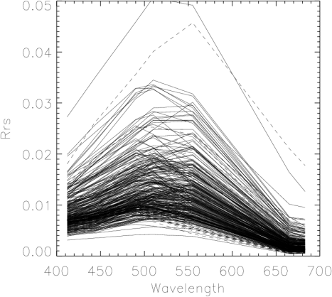
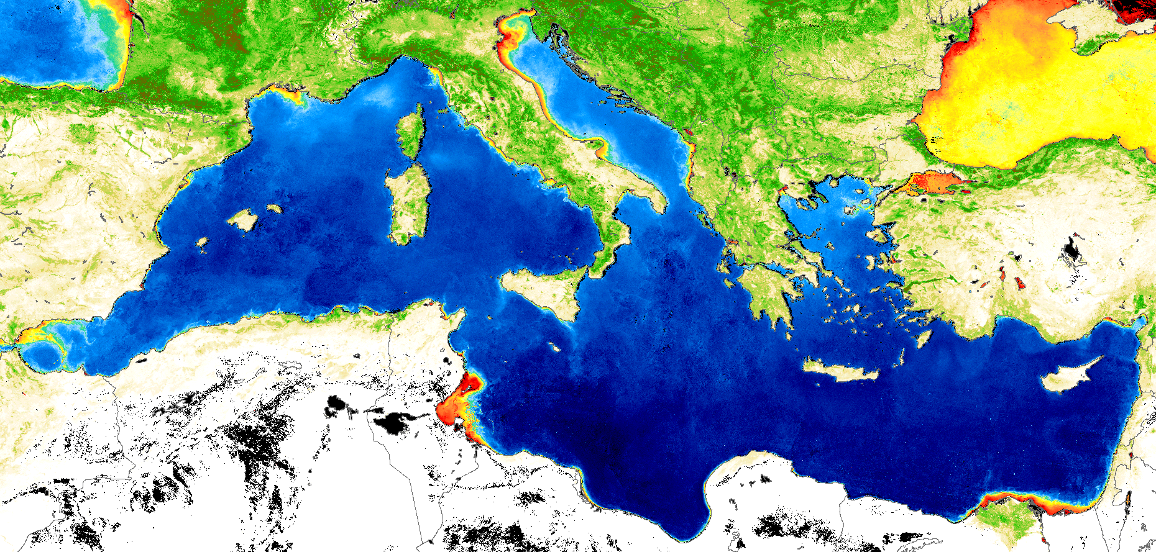
Bio-optical models: the tools to convert satellite atmospherically corrected data into high-level products
statistical
Chla~f(R_{rs}(λ₁),R_{rs}(λ₂))
Satellite derived marine signal (“Reflectance” R_{rs})
Seawater Optically Significant Components (Phytoplankton biomass, Suspended & Dissolved Matter).
a,b_{b}~ℑ(R_{rs}(λ))
Chla~ƒ (λ, a, b_{b})
semi-analytical

Slide 12
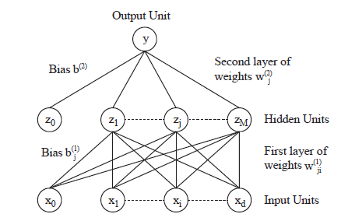
Schematic of MLP with two layers of adaptive parameters
D. D’Alimonte, G. Zibordi, J.-F. Berthon, E. Canuti and T. Kajiyama. Bio-optical Algorithms for European Seas: Performance and applicability of Neural-Net Inversion Schemes. JRC Scientific and Technical Report EUR 24920 EN (2011).

Slide 13
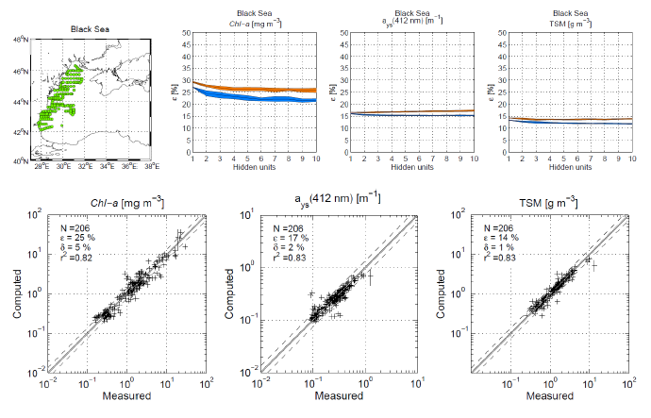
Performance of the BiOMaP MLP NN for various ocean color products
D. D’Alimonte, G. Zibordi, J.-F. Berthon, E. Canuti and T. Kajiyama. Bio-optical Algorithms for European Seas: Performance and applicability of Neural-Net Inversion Schemes. JRC Scientific and Technical Report EUR 24920 EN (2011).

Slide 14
Future developments
Expand current AOP Analysis including Data from the NATO Project;
Investigate AOP Features at Sub-Basin Level;
Investigate Commonalities in Bio-Optical Features between Black Sea and other EU Seas.

